Slide 1
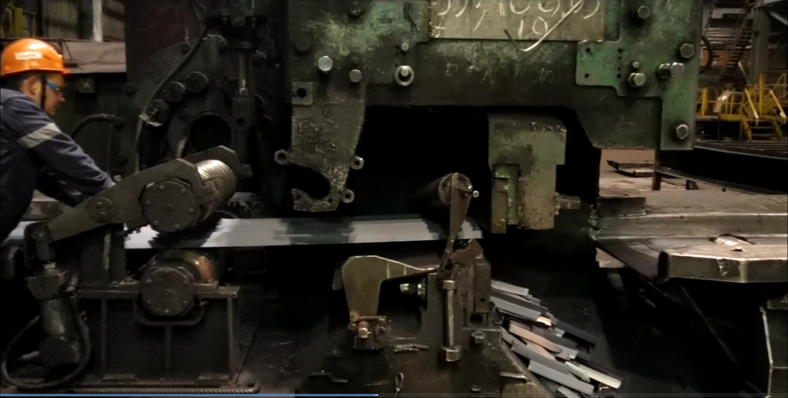

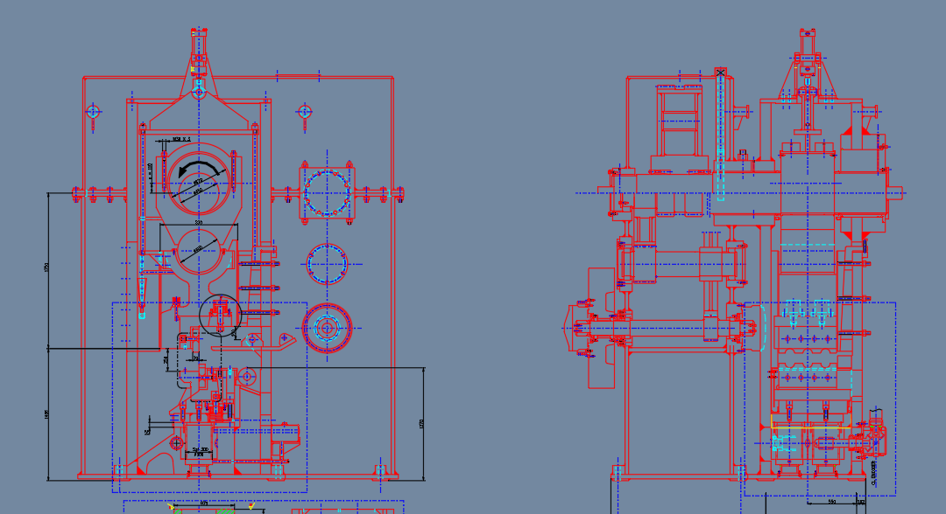
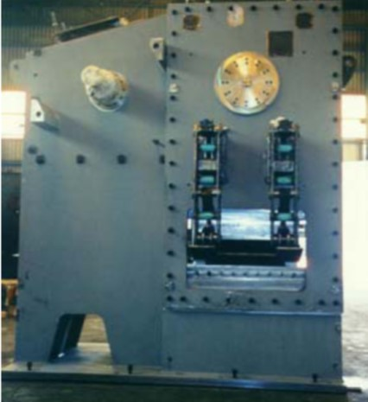
Contact us : sales@stetechnology.com
MENU (che ricollega le finestre sotto + video che scorrono o foto)
Our mission
Worldwide
Rolling Cold Shear
STEB can design cold cutting shear for bars and profile , complete with cutting measuring system and pinch roll
Typically dseign of cutting shear 300-500-800 ton

